Slide 1
Iterating ArrayList in 6 different ways.

Slide 2
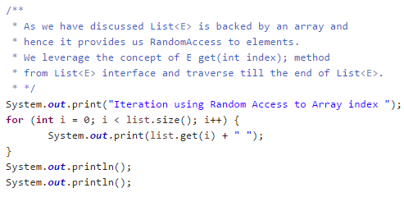
1. Iterating using size() and get(index) method

Slide 3
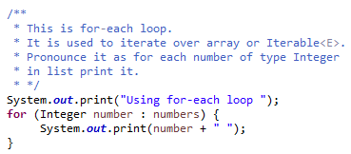
2. Iterating using enhanced for loop

Slide 4
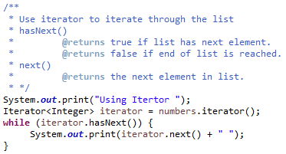
3. Iteration using Iterator

Slide 5
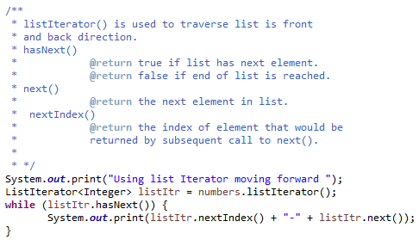
4. Iteration using ListIterator(move forward)

Slide 6
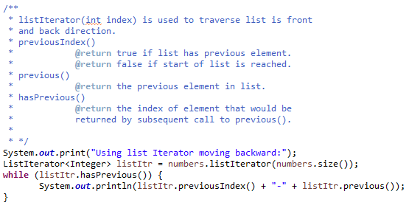
5. Iteration using ListIterator(move backward)

Slide 7
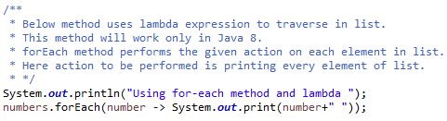
6. Java 8 Internal Iteration using for-each method

